Slide 1
Introduction
IT 426

Slide 2
What we will cover
Design Tools (UML)
Code Design
Design Patterns
Design Architectures

Slide 3
UML
The Unified Modeling Language

Slide 4
Unified Modeling Language
“The Unified Modeling Language (UML) is a family of graphical notations … that help in describing and designing software systems, particularly software systems built using the object-oriented style.”
-Martin Fowler (UML Distilled)

Slide 5
Categories of UML diagrams
Structural Diagrams
Class Diagram
Package Diagram
Behavioral Diagrams
Activity Diagram
Sequence Diagram
Object Diagram
Composite Structure Diagram
Deployment Diagram
Use Case Diagram
State Diagram
Communication Diagram
Timing Diagram
Interaction Diagram
Defines the structures (objects, classes,
machines, network nodes, modules, etc…)
that are part of a software system.
Defines the interactions (method calls,
message passing, state transitions,
user choices, etc…) between entities in a
software system.

Slide 6
The landscape
Diagram
Structure Diagram
Profile Diagram
Composite Diagram
Component Diagram
Deployment Diagram
Package Diagram
Object Diagram
Class Diagram
Behavior Diagram
Use Case Diagram
Activity Diagram
Interaction Diagram
Sequence Diagram
Communication Diagram
Timing Diagram
State Machine Diagram

Slide 7
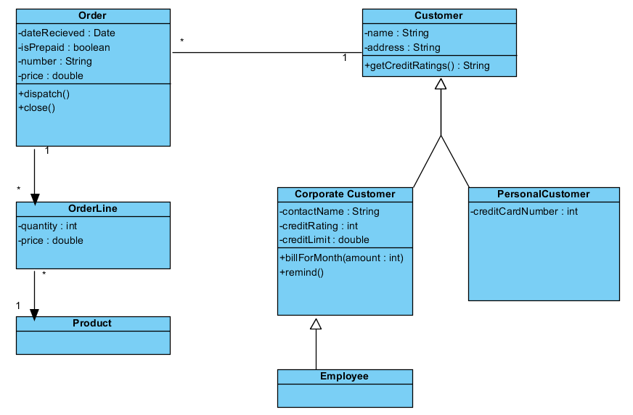
Representing our classes

Slide 8
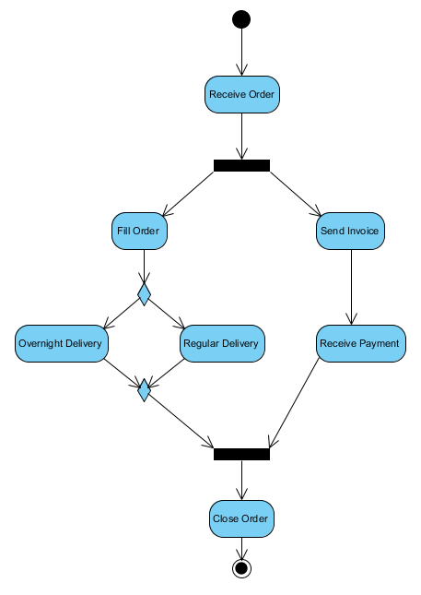
Decomposing actions

Slide 9
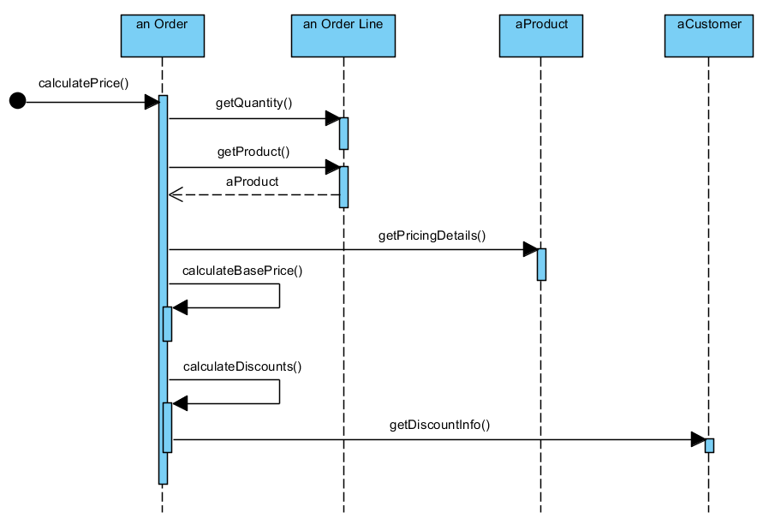
Modeling control flow

Slide 10
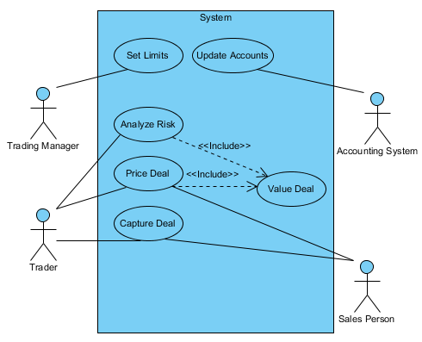
Representing users stories

Slide 11
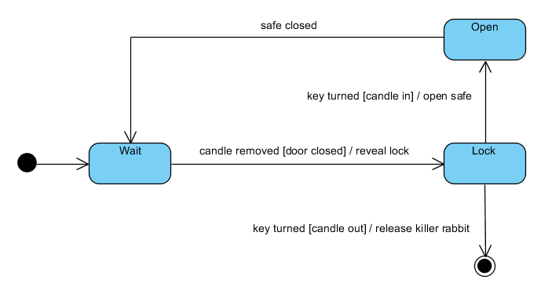
State transitions

Slide 12
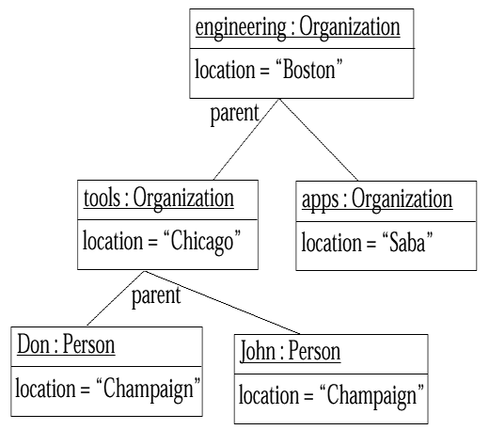
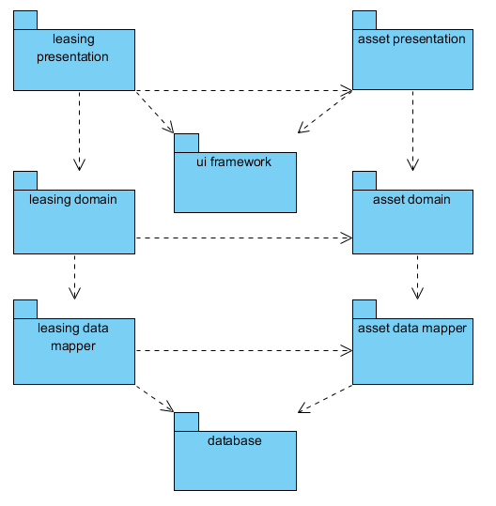
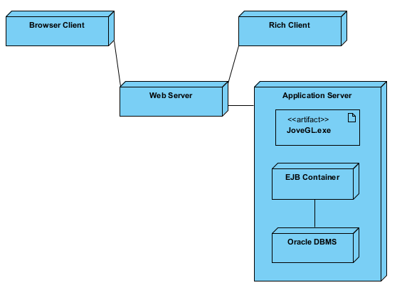
Other UML Diagrams
Object Diagrams
Package Diagrams
Deployment Diagrams
“… a snapshot of the objects
in a system at a point in time.”
“… [show] packages and their
dependencies.”
“… show a system’s physical
layout, revealing which pieces
of software run on what pieces
of hardware.”

Slide 13
Code Design
“… it is through practice in the small that professionals gain proficiency and trust for practice in the large.”
James O. Coplien

Slide 14
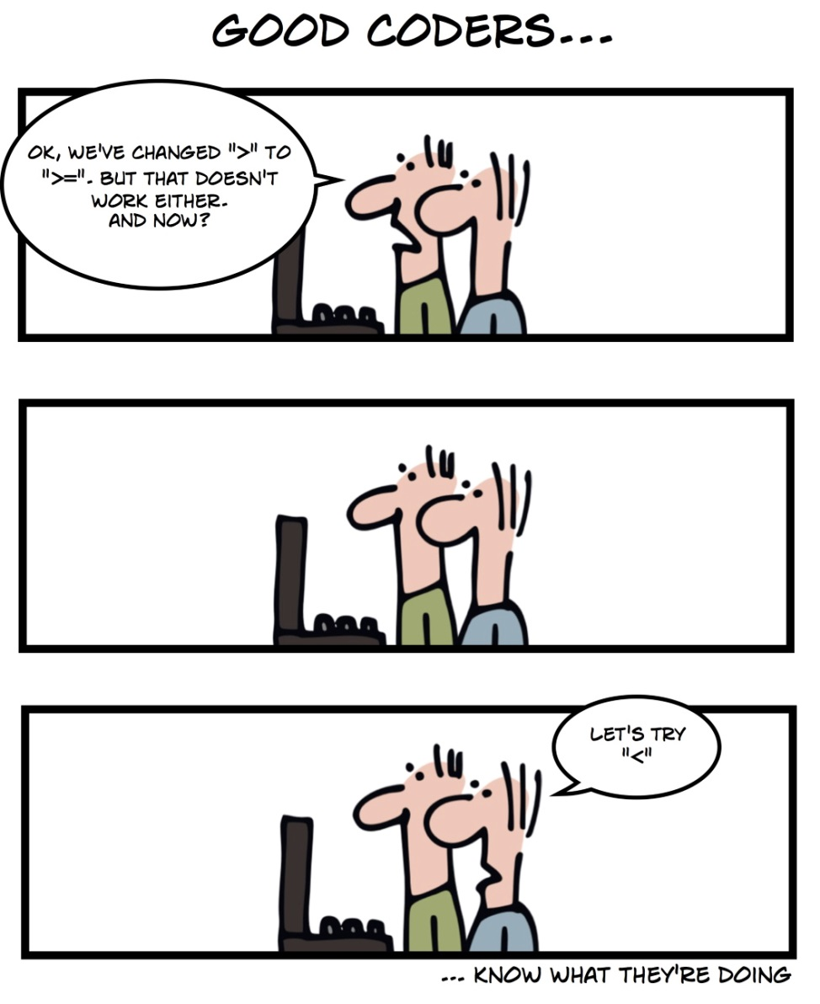
Code Design
Goals for our code as developers
Reusable
Maintainable
Flexible/Extensible
No redundancy
Loosely coupled
High cohesion
Scalable

Slide 15

Something to Consider
Have I ever let my code get unmanageable?
Do small decisions hurt my code in the long run?
Overly complex?
Messy?
Unreadable?
At some point can I confirm that my code is readable?
What is “kludgy code?”
Do I have bad habits from needing to “get the job done?”
Notes:
Kludgy: Awkwardly or inelegantly made or done.

Slide 16

What is Clean Code?
What makes code easy to maintain and update?
What can we do about it?

Slide 17

Bjarne Stroustrup
Inventor of C++
“I like my code to be elegant and efficient. The logic should be straightforward to make it hard for bugs to hide, the dependencies minimal to ease maintenance, error handling complete according to an articulated strategy, and performance close to optimal so as not to tempt people to make the code messy with unprincipled optimizations. Clean code does one thing well.”

Slide 18
Grady Booch
Author of “Object Oriented Analysis” and “Design with Applications”
“Clean code is simple and direct. Clean code reads like well-written prose. Clean code never obscures the designer’s intent but rather is full of crisp abstractions and straightforward lines of control”
Notes:
Prose is a form of language that has no formal metrical structure. It applies a natural flow of speech, and ordinary grammatical structure rather than rhythmic structure, such as in the case of traditional poetry.

Slide 19
Dave Thomas
Founder and past CEO of Object Technology International Inc.
“Clean code can be read, and enhanced by a developer other than its original author. It has unit and acceptance tests. It has meaningful names. It provides one way rather than many ways for doing one thing.”

Slide 20
Michael Feathers
Author of “Working Effectively with Legacy Code”
“Clean code always looks like it was written by someone who cares. There is nothing obvious that you can do to make it better. All of those things were thought about by the code’s author, and if you try to imagine improvements, you’re led back to where you are, sitting in appreciation of the code someone left for you – code left by someone who cares deeply about the craft.”

Slide 21
Ron Jeffries
Author of “Extreme Programming Adventures in C#”
“- Runs all tests.
- Contains no duplication.
- Expresses the design ideas that are in
the system.
- Minimizes the number of entities
such as classes, methods, functions
and the like.”

Slide 22
What does this mean for me?
We are going to study how professionals write elegant code. We will learn rules like:
DRY - don’t ever, ever, ever, repeat yourself in code
Methods should be short, and only do ONE thing
Variable, method and class names should be self-revealing
Commenting does not make up for bad code!
Avoid writing bad comments.
A class should only have ONE reason to change
Don’t misuse the null keyword.
…

Slide 23
Design Patterns
“Controlling complexity is the essence of computer programming.”
Brian Kernighan

Slide 24
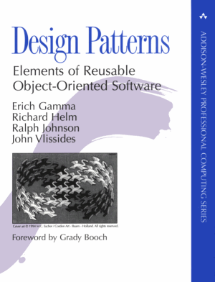
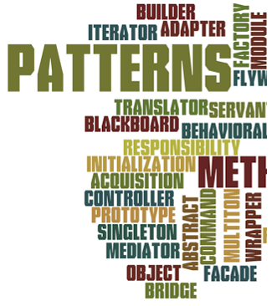
Some questions
What is a design pattern?
Well known solutions for well known problems
Reusable solutions!
Who are the gang of four?

Slide 25
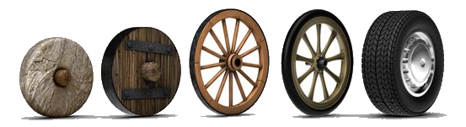
Why learn design patterns?
Going a step beyond our understanding of OOP
Better understand existing code frameworks
Don’t reinvent the wheel
Use the expertise of those who went before us
Use well-known, proven, techniques for solving problems

Slide 26
How do we learn design patterns?
Learn the vocabulary
Pattern names : Strategy, Factory, Bridge, etc…
Pattern categories
Creational | Structural | Behavioral
Abstract Factory Builder Factory Method Lazy Initialization Multiton Prototype Singleton | Adapter Bridge Composite Decorator Façade Flyweight Front Controller Proxy | Chain of Responsibility Command Iterator Mediator Memento Observer State Strategy Template Method Visitor

Slide 27
How do we learn design patterns?
Learn the technique
Strategy pattern can be used to solve problem ____, which will require us to build ____ classes with ____ relationships…
Avoid misusing the pattern
Learn patterns that are proven to result in bad design (Anti Patterns)
Pogo stick navigation
Lava flow
Premature optimization
Analysis paralysis

Slide 28
How do we learn design patterns?
Learn the principles
Program against interfaces, not implementations
Find what varies and encapsulate it
Prefer composition
over
inheritance.

Slide 29
Design architectures
“MVC [Model-view-controller] is not a design pattern, it is an Architectural pattern that describes a way to structure our application and the responsibilities and interactions for each part in that structure.”

Slide 30
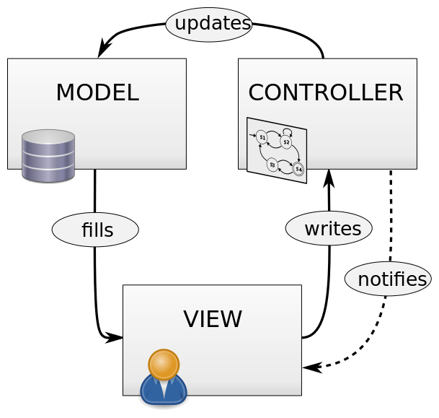
Structuring our application
Model-view-controller (MVC)
Focus: Separation of Concerns
Components
View: user interfaces
Model: data layer (database, files, …)
Controller: manages interactions between Model and View

Slide 31
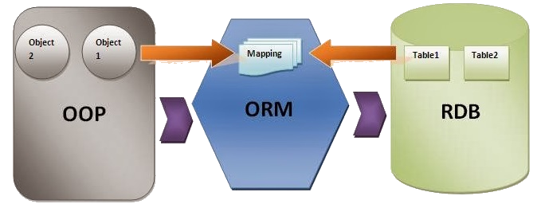
The Active Record Pattern
Also called Object Relational Mapping
Letting a framework write our data layer
ORM frameworks
PHP: Propel
Java: Hibernate
C#: Entities Framework
…

Slide 32

Inversion of control
Also called dependency injection
Used in different enterprise frameworks
Java: Spring Framework
What is it?
“When applying [dependency injection], [objects] are given their dependencies at creation time by some external entity that coordinates each object in the system. In other words, dependencies are injected into objects."

Slide 33
Sources
Martin, Robert C. Clean Code. New Jersey: Pearson Education Inc, 2009.
Fowler, Martin. UML Distilled. New Jersey: Pearson Education, 2004.
Pastor, Pablo. "MVC for Noobs." 24 3 2010. code.tutsplus.com. 1 9 2016. <https://code.tutsplus.com/tutorials/mvc-for-noobs--net-10488>.
Binstock, Andrew. “Excellent Explanation of Dependency Injection (Inversion of Control).” JavaWorld, JavaWorld, 22 Jan. 2008, www.javaworld.com/article/2071914/excellent-explanation-of-dependency-injection--inversion-of-control-.html. Accessed 14 Sept. 2017.

Slide 34
Introduction
IT 426

